Slide 1

Android Assignment moFaim
Rishikesh Poorun

Slide 2
moFaim – Project Description
To make an Android mobile application that contains a repository of restaurants which will help a user find nearby food corners.
The mobile should allow user to register and authenticate prior using the app features
The user should have access to a dashboard with search, share and select options
The mobile should provide details of the menu
The user should be able to call, rate and/or locate on map

Slide 3
moFaim – Application Structure
Activity Layer
This layer handles all of the user responses and action on the mobile application Responsible for populating the fragments, views and listen for notification Responsible for providing the user with third-party options for sharing
Business Layer
This layer contains all the logical processing of data and information This layer handles user inputs, and validations also the application exceptions during runtime. It also contains the application logical tools and utilities.
Data Layer
This layer abstract the application from handling the data to and from a database The point of entry is the repository layer, the DAO handles the manipulation and return the data to the business layer This layer can handle the async tasks

Slide 4

moFaim – Using Fragment Layout
The use of Fragment allows the mobile app to have multiple instances of data view on the same activity screen
Each fragment of the activity can be attached to different threads and run independently to populate the views with LiveData
Thread 2
New Data
On Screen information Fragment 2
Thread 2
On Screen Information
Fragment 1
New Data

Slide 5
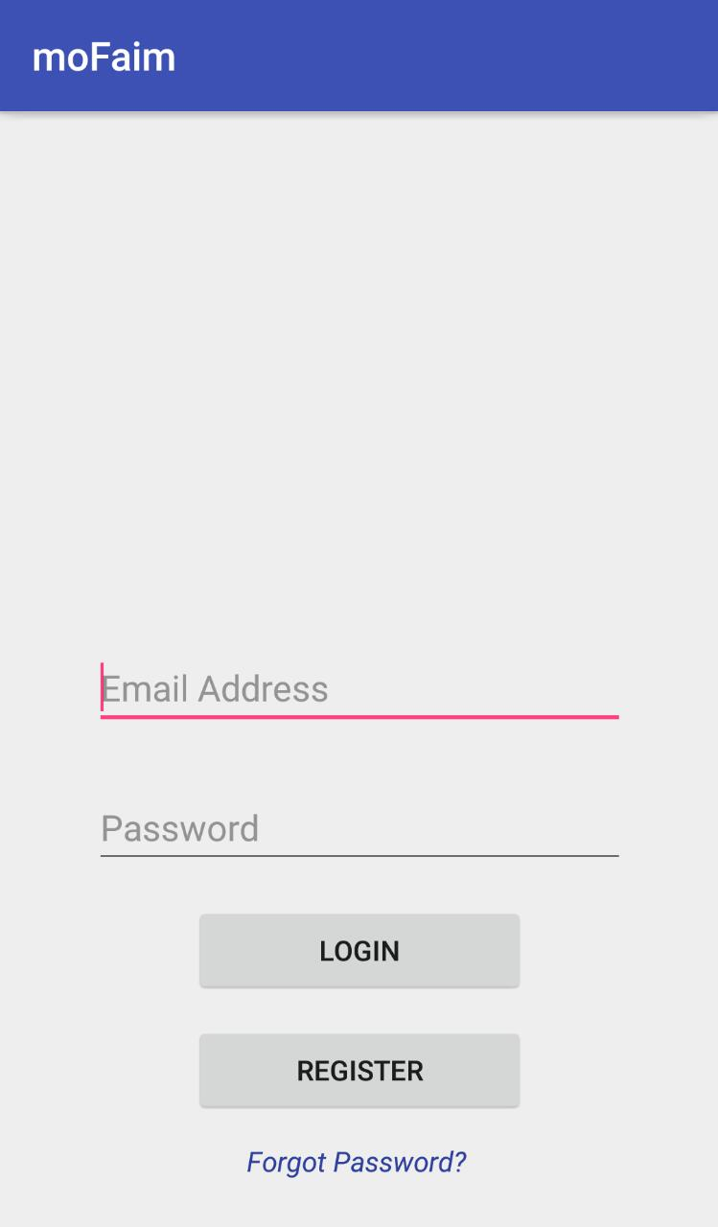
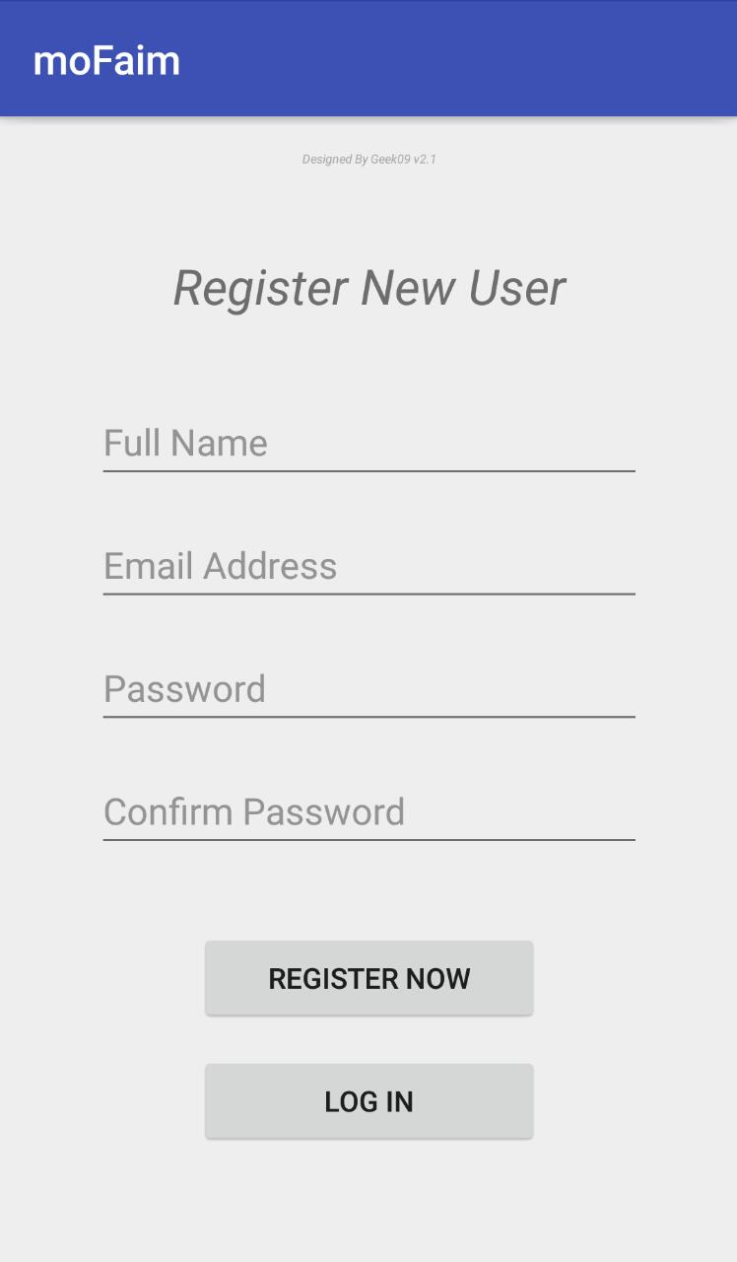
moFaim – Input Validation
The user needs to register to be able to use the application
To prevent wrong insertion of data, and ensure appropriate data type and context are fed by the user, all inputs by the user directly are validated prior processing else the user is warn via a status message
All fields of the app contains validation

Slide 6
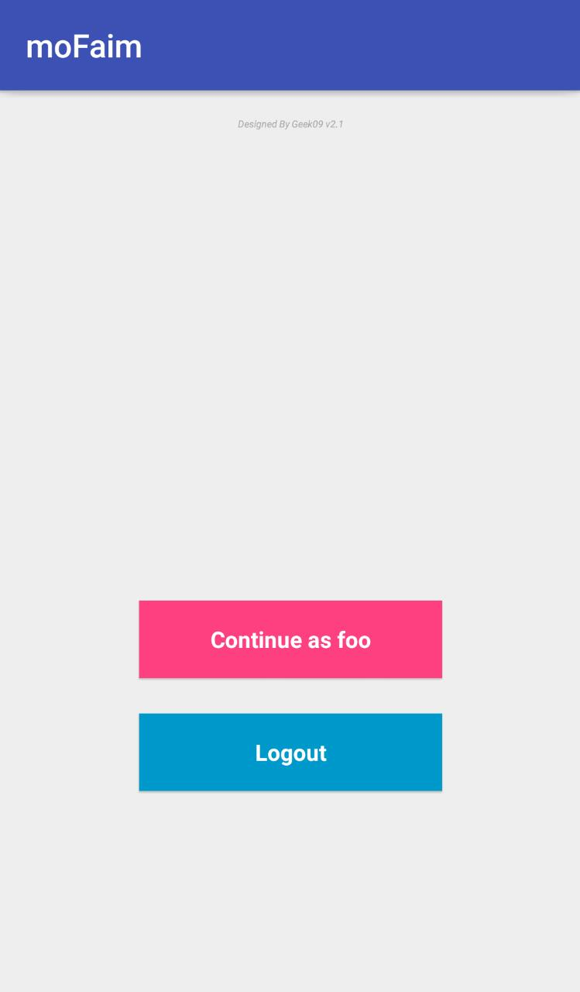
moFaim – Shared Preferences
By using the android in-build shared preferences feature, data can be persisted locally and retrieved much faster than a database
The application make use of shared preferences to create a session for the currently logged user, thus avoid repetitive actions
Session allow user to log quickly without typing credentials again

Slide 7
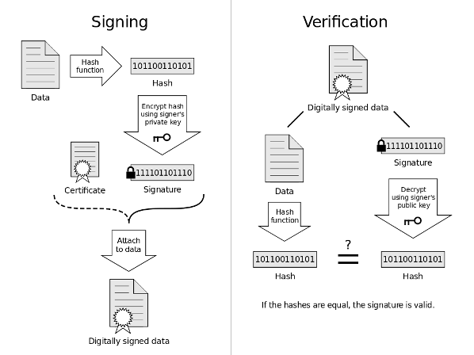
moFaim – GDPR
To protect the user data, sensitive information captured from the user are encrypted with a unique key and persisted.
To validate the information, data is sought from user and encrypted again and compared with previous version
The user in-session data generated (Location, search queries) are not persisted, but flushed once its purpose or the activity is terminated

Slide 8
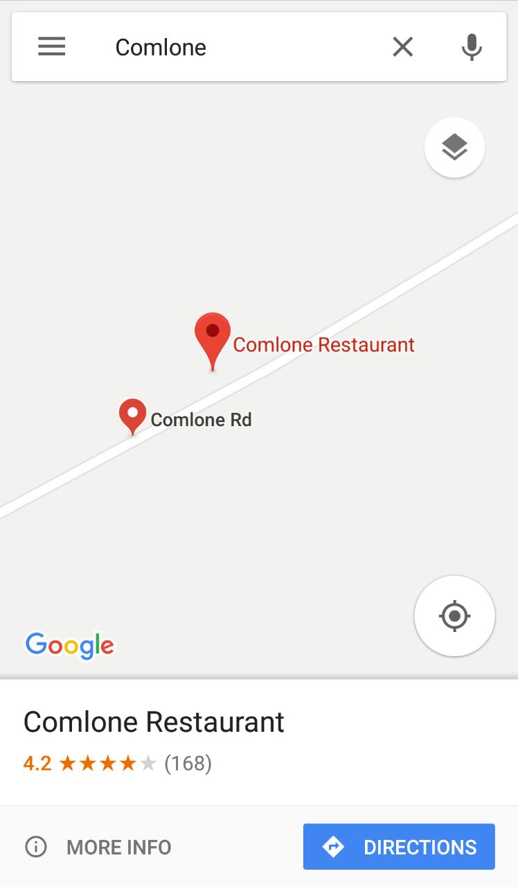
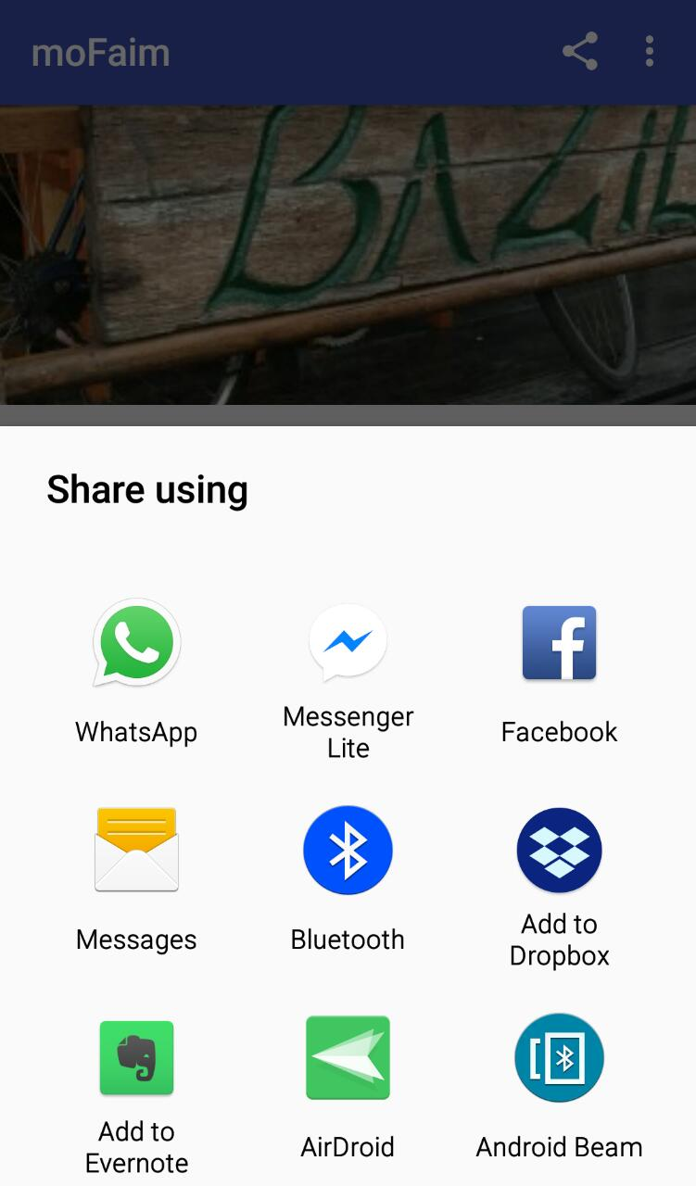
moFaim – Native Intents
Using the native implementation of android Intents to call for services thus enabling features such as call, locate on map, share onto social media
These features requires the User permission in accordance to Google policy

